Slide 1
Task 1. Web scraping to gain company insights
Adilet Mussabekov
2024

Slide 2
Methodology and Key Findings
Data Collection: Leveraged BeautifulSoup and Requests in Python to scrape customer reviews from airlinequality.com, capturing a significant dataset from 10 pages of reviews.
Data Preparation: Employed NLTK for cleaning text data, tokenization, POS tagging, stopwords removal, and lemmatization to prepare data for analysis.
Analysis Technique: Conducted sentiment analysis with VADER Sentiment Analysis, classifying reviews into positive, neutral, and negative sentiments for in-depth insight.
Sentiment Analysis Results: A significant portion of reviews expressed positive sentiments, with a smaller percentage of neutral and negative sentiments.
Positive Feedback Highlights: Customers praised specific aspects of their experience, underscoring British Airways' strengths.
Areas for Improvement: Negative reviews shed light on specific areas requiring attention, offering opportunities for enhancement.

Slide 3
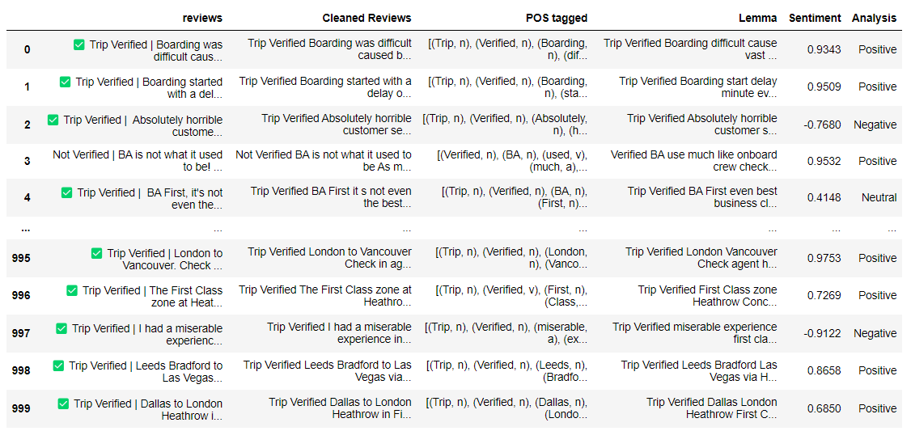
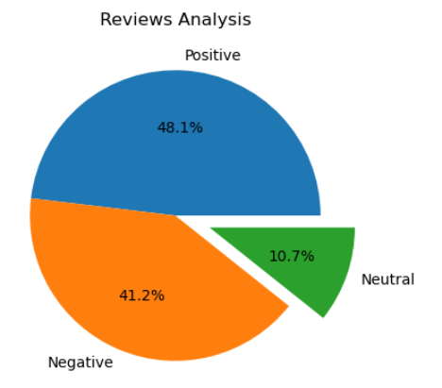
Results. Visualizations of Customer Feedback

